Slide 1
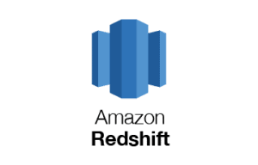

Project Group 8
ISM6218 - Advanced Database Management

Slide 2


Group Members
Vinesh Narendra Sangoi (U55816884)
Leelamahesh Chakravarthy Kodi (U28275523)
Neha Satpute (U19160274)
Payal Samanta (U76228941)

Slide 3
What is Amazon Redshift ?
Amazon Redshift is a fully managed data warehousing service provided by Amazon Web Services (AWS). It is designed to handle large-scale data analytics workloads.
Redshift is based on a columnar storage architecture and is optimized for high-performance analysis and reporting.
Amazon Redshift serves as a powerful platform for SQL-based data analysis and ETL processes, providing high-performance query capabilities and robust support for data integration and transformation.

Slide 4
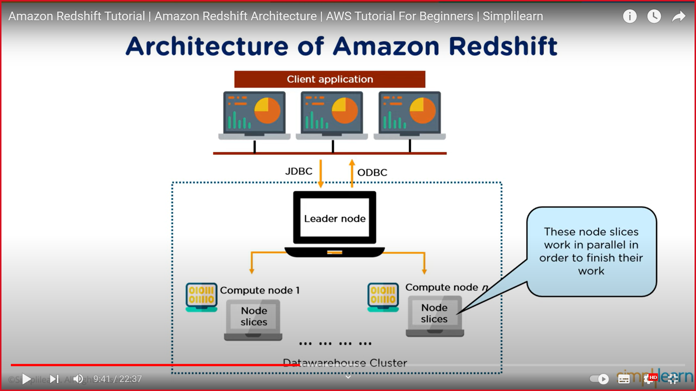
Amazon redshift architecture

Slide 5

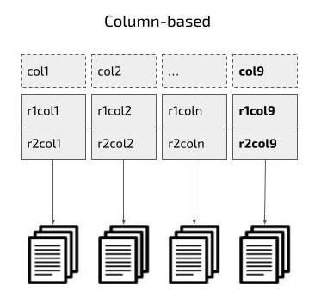
Why amazon redshift is used for analytical purpose?
Column storage- Query optimization, resulting in quicker outputs
Example:
Compression –column level operation which decreases storage requirements
Massive Parallel Processing (MPP): Massive Parallel Processing (MPP): Redshift distributes data and query load across all nodes, allowing for fast data analysis and database queries.

Slide 6
Other reasons
Concurrency Control: Redshift provides robust concurrency control, allowing multiple users to run complex analytical queries simultaneously without significant performance degradation.
SQL Compatibility: Redshift supports standard SQL, making it accessible to analysts and data scientists who are familiar with SQL. This ensures compatibility with a wide range of business intelligence tools and applications.
Security and Compliance: Amazon Redshift offers a range of security features, including encryption, user authentication, and access control. It also complies with various industry and regulatory standards.

Slide 7
Features of Redshift
Amazon Redshift is often considered a more effective ETL solution compared to Microsoft SQL Server due to several factors:
Scalability for effective management : Redshift is designed to handle large-scale datasets, scaling up to petabytes, and analysis of massive volumes of data.
Cost-Efficiency: you pay only for the resources you use, more economical than SQL Server's licensing model​​.
Fully Managed: it automates many administrative tasks such as backups, scaling, and monitoring, which can be more labor-intensive in SQL Server environments​​.

Slide 8
Features of Redshift
Redshift offers optimized query performance with features like columnar storage, data compression, and zone maps.
Redshift ensures robust security and reliability through network isolation, encryption, and high availability with continuous backup to Amazon S3.
SQL Server is suitable for Windows environments, known for relational DB management, data recovery, and restoration.
Redshift excels in large-scale cloud-native ETL operations, while SQL Server is preferable for traditional on-premises database management.

Slide 9
Advantages of amazon redshift over MYSQL
Concurrency: Redshift can handle a large number of concurrent ETL jobs without significant performance degradation. MySQL might struggle with concurrency at scale, which can be a bottleneck for ETL processes.
Maintenance: Redshift is a managed service, which means AWS takes care of much of the maintenance work, like backups and patching. MySQL requires manual intervention for these tasks unless managed by a service like Amazon RDS.
Integration with Data Ecosystem: Redshift is part of the AWS ecosystem, making it easy to integrate with other AWS services like AWS Data Pipeline, AWS Glue, AWS Lambda, and S3 for a comprehensive ETL solution. MySQL can integrate with these services but may not have the same level of native integration.
Optimized for Analytics: Redshift is specifically optimized for complex queries and analytics workloads, which are common in ETL processes, especially the transformation stage. MySQL is a general-purpose database and is not specifically optimized for analytics.
Data Warehousing Features: Redshift supports data warehousing capabilities such as materialized views, which can pre-aggregate data and speed up ETL processes. MySQL does not natively support such features.
Cost: While both services offer pay-as-you-go pricing, Redshift's cost is predictable when it comes to data warehousing operations. MySQL could potentially be less expensive for smaller workloads but might become costly as the need for scaling and performance optimization increases.
Security: Redshift offers robust security features, including encryption at rest and in transit, AWS VPC for network isolation, and compliance certifications. While MySQL also offers security features, implementing them at scale and in the cloud may require additional effort.

Slide 10
Disadvantages of amazon Redshift over MYSQL
Complexity and Expertise: Redshift may require a steeper learning curve and more expertise to manage effectively.
Data Loading and Updates: Bulk data loading into Redshift can be very fast, but incremental updates and deletes can be more cumbersome compared to SQL databases that are optimized for OLTP.
Concurrency Limitations: There may still be limitations compared to traditional SQL databases in handling a high number of concurrent transactions.
Limited Support for Unstructured Data: Redshift is primarily designed for structured data and might not be as effective for analysis of unstructured data.
In summary, Amazon Redshift provides powerful data warehousing capabilities but may present challenges in cost, complexity, and certain operational aspects compared to traditional SQL databases, especially for smaller-scale or transaction-heavy applications.

Slide 11
Companies using amazon redshift
Amazon Redshift is employed across various industries, given its scalability and performance benefits for data warehousing and analytics. Here are some industries that commonly use Redshift:
Financial Services: Banks and financial institutions use Redshift for risk analytics, real-time fraud detection, transaction analysis, and to meet regulatory and compliance requirements.
Healthcare: To analyze patient data, improve treatment outcomes, manage operational efficiency.
Retail and E-commerce: For customer behavior analytics, supply chain optimization, sales forecasting.
Transportation and Logistics: To optimize routes, manage fleets, analyze travel data, and improve operational efficiency
Government: Public sector agencies for managing and analyzing large datasets, including urban planning, resource management, and public services.
These industries benefit from Redshift's ability to quickly analyze large volumes of data and derive meaning insights, which is in today's data-driven economy.

Slide 12
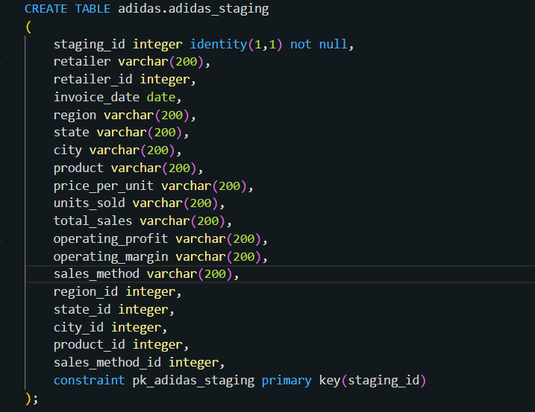
ETL Process:

Slide 13
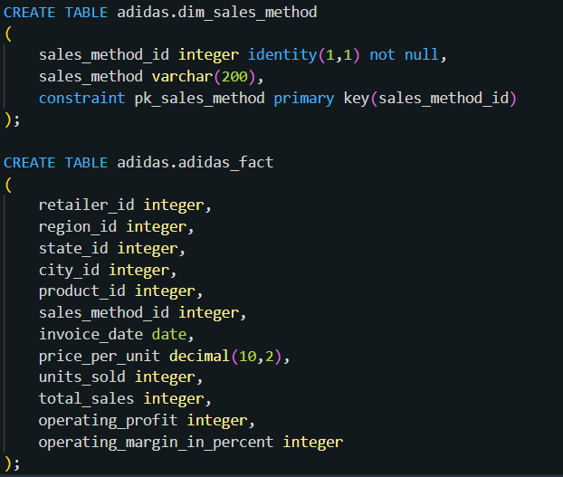
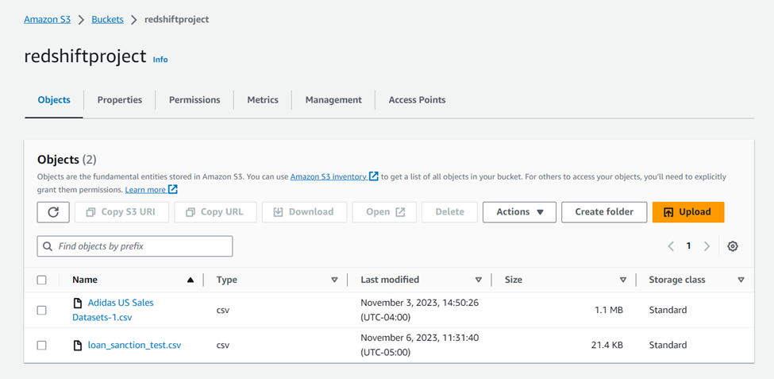

Slide 14
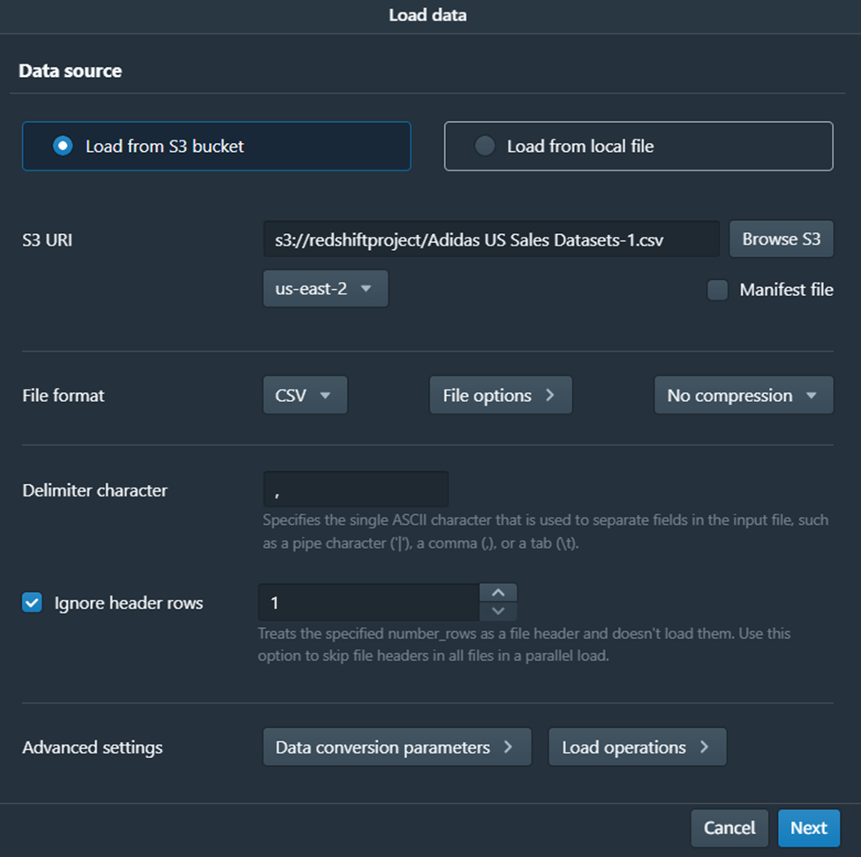

Slide 15
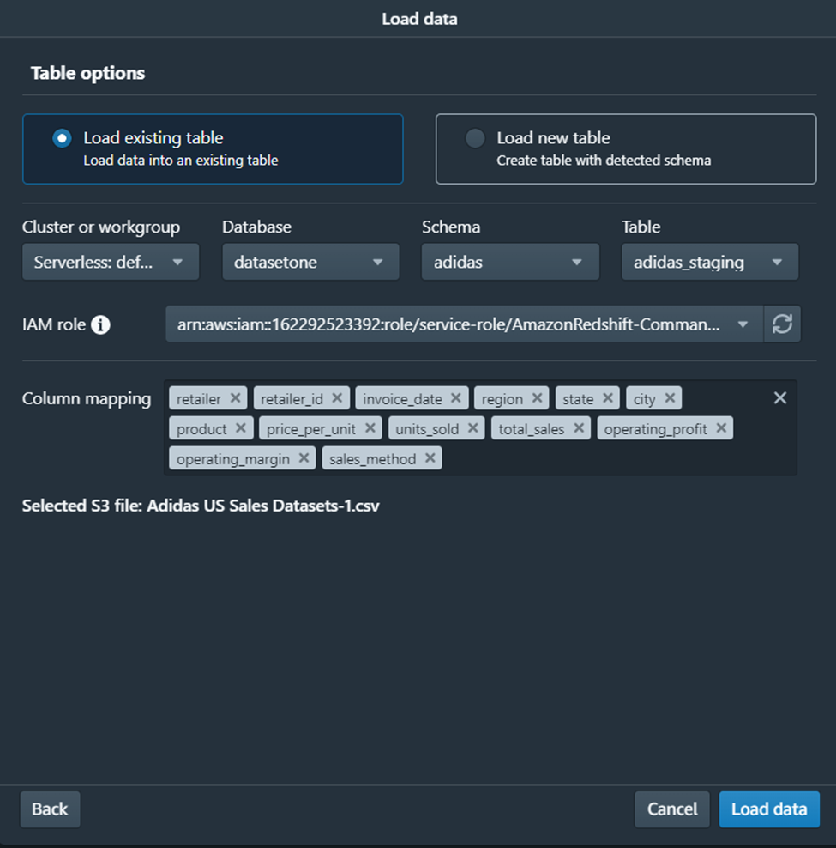

Slide 16
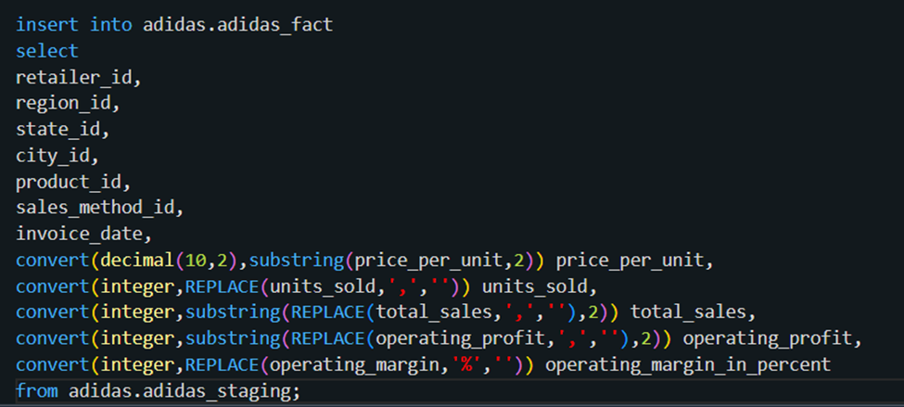
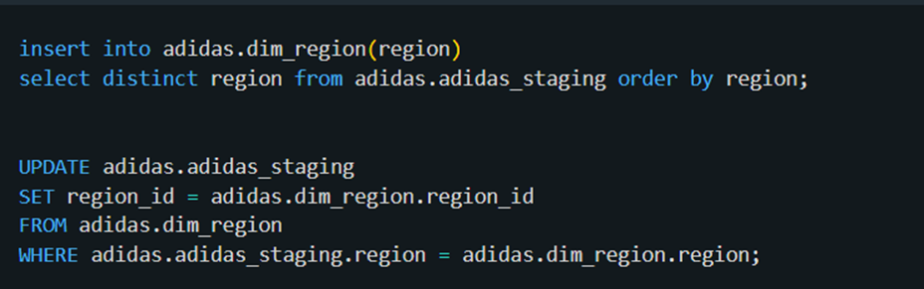

Slide 17
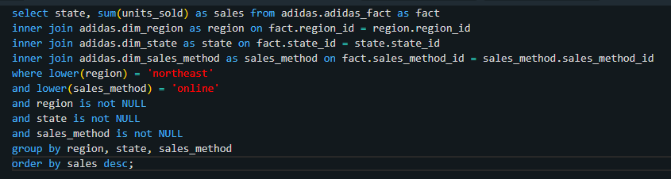
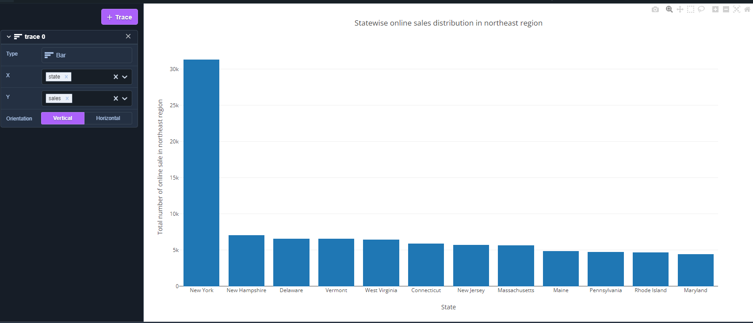

Slide 18
Teams meeting link
https://usfedu-my.sharepoint.com/:v:/g/personal/kodi1_usf_edu/EXfeYNTdvpJLl26PBjQhNTgBYrRtKF1ls3_KFwxR7N7wNQ

Slide 19

THANK YOU

